Slide 1
Intro to Unit Testing using IBMiUnit
Fall 2019
Marina Schwenk
Software Developer

Slide 2
What is Unit Testing?
Breaking apart your application and testing each part
It’s a program that will call your production program/procedure
Test its behavior and/or output
Separate pieces that gets tested before the final program is completed

Slide 3
Why Unit Test?
Peace of mind
Good for program modifications
Good for defining what your program needs to do, before you write the program
Test cases will build over time

Slide 4
Why Unit Test?
Improved code
Validates existing behavior

Slide 5
What is IBMiUnit?
RPG open source unit testing framework
Streamlines unit testing of RPGLE programs and procedures

Slide 6
IBMiUnit Goals
Repeatable automated testing
Easily test external interfaces
Follow industry standards

Slide 7
What IBMiUnit is Not
Subroutine testing
Integration testing
Automatic
Magic

Slide 8
How to Use IBMiUnit
Install IBMiUnit Library
Create test program
Write one or more tests
Run the tests

Slide 9
Installation
Go to https://github.com/MarinaSchwenk/IBMiUnit
Download the SAVF file to IFS
Create library IBMiUnit
Restore IBMiUnit library.

Slide 10
Dependencies
OSSILE
Go to https://github.com/OSSILE/OSSILE
Download the repo
Follow the build instructions listed on the project

Slide 11
Internals of IBMiUnit Library
Four (five?) run-time objects
RUNTEST *PGM and *CMD
IBMiUnit *SRVPGM
IBMiUnit *MSGF
Appropriate UI plug-in program
Two compile-time objects
/copy IBMiUnit/QRPGLESRC(IBMiUnit_H)
IBMiUnit *BNDDIR
All UI text in the message file (future goal)

Slide 12
Internals of IBMiUnit Library, UI Plug-Ins
DSPLY
Very simple UI
Simply uses the DSPLY op-code for all possible feedback
Interactive
Intuitive and easy-to-follow
Progress bar with test result feedback

Slide 13
Internals: Future Possibilities
Build scripts
Easy run of SQL scripts
Ability to run a single test from the command line
Additional UI modules
XML output
Interface with Rational Developer for i

Slide 14
Create Test Program
No parameters
bndDir( 'IBMiUnit' )
/copy IBMiUnit/QRPGLESRC,IBMiUnit_H
Main body of the program
call IBMiUnit_setupSuite() (one-time)
call IBMiUnit_addTestCase() (for each test case)
call IBMiUnit_teardownSuite() (one-time)
return

Slide 15
IBMiUnit Initialization
IBMiUnit_setupSuite()
Initializes the IBMiUnit library to run tests in the program
Parameters (all optional)
Name for the test suite
Address of sub-procedure to call before each test
Address of sub-procedure to call after each test
Address of sub-procedure to call once before any tests in the program are called
Address of sub-procedure to call once after all tests in the program are completed
Example
IBMiUnit_setupSuite( 'MathTests' );

Slide 16
IBMiUnit Test Case
IBMiUnit_addTestCase()
Identifies or ‘links’ a test case into the suite
Parameters (no return value)
Address of a test case sub-procedure
No parameters or return values
Name of test case; optional but greatly helps you understand the test output and find the problem
Example
IBMiUnit_test( %pAddr( add_twoNumbers ) : 'add_twoNumbers' );

Slide 17
IBMiUnit Test Suite
IBMiUnit_addTestSuite()
Adds a set of test cases (suite) to a parent set
Not all test programs will use this
Parameters
Name of test program
Library of test program
Optional, defaults to *LIBL
Example IBMiUnit_addTestSuite( 'TEST_ACHAR' );

Slide 18
IBMiUnit Teardown
IBMiUnit_teardownSuite()
Wraps up test suite
No parameters
Every IBMiUnit_setupSuite() needs a corresponding IBMiUnit_teardownSuite()
Example
IBMiUnit_teardownSuite();

Slide 19
Write a Test Case: Interface
Sub-procedure without parameters or a return value
Name the test case with the name of the sub-procedure
Example
Writing a test case to test the return value from a sub-procedure named multiply
Calling the sub-procedure with positive values
Test case named multiply_twoPositives
Other test case names: multiply_positiveByZero, multiply_zeroByZero, multiply_twoNegatives, …

Slide 20
Write Test Case: Logic
Call sub-procedure with test data
Compare actual result with the expected result
Trigger failure when they don’t (or do) match

Slide 21
Write Test Case: Failure Detection
Always fail, i.e. you write the condition and call fail()
Conditionally fail, or test for failure; many possibilities
All start with assert
Indicator tests
On / Off
Pointer tests
Null / NotNull
Variable tests / comparisons
RPG doesn’t have overloading so next word is a type
Char, Date (ISO), Float, Numeric, Time (ISO), Timestamp
Character tests work on values up to a length of 250
Numeric is used for non-float numbers; size is 60,25

Slide 22
Write Test Case: Test Procs
fail()
Message to display; optional
assertOn(), assertOff(), assertNull(), assertNotNull()
Actual value; required
Message to display on failure; optional
assertFloatXxx()
Expected value; required
Actual value; required
Delta (leeway; allowable difference); required
Message to display on failure; optional
assertXxx() (everything else)
Expected value; required
Actual value; required
Message to display on failure; optional

Slide 23
Write Test Case: Examples
if ( %scan( 'TEST' : value ) <> 1 ); fail( 'value does not start with TEST' ); endIf; assertOn( rowFound, 'Row not found' ); assertCharEquals( expected, actual, 'Name' ); assertNumericEquals( 12.00, extendedAmount, 'Item price' ); assertDateEquals( today, invoiceDate, 'Invoice date' );

Slide 24
Run Tests
Call RUNTEST command
Example
IBMIUNIT/RUNTEST SUITE(TEXTUTIL_T) UI(*INT)
No feedback if all tests are successful
Helps you focus on the problems

Slide 25
Result Status
Successful
Failure
A state detected by your code
From fail() or assertXxx()
Error
A problem encountered, but not detected, by your code
Level check, divide by 0, array index out of bounds, …

Slide 26
Best Practices
Naming sub-procedures
Internal vs External include files
Keep test code separate from production code

Slide 27
Any Questions?

Slide 28
Demo Time!

Slide 29
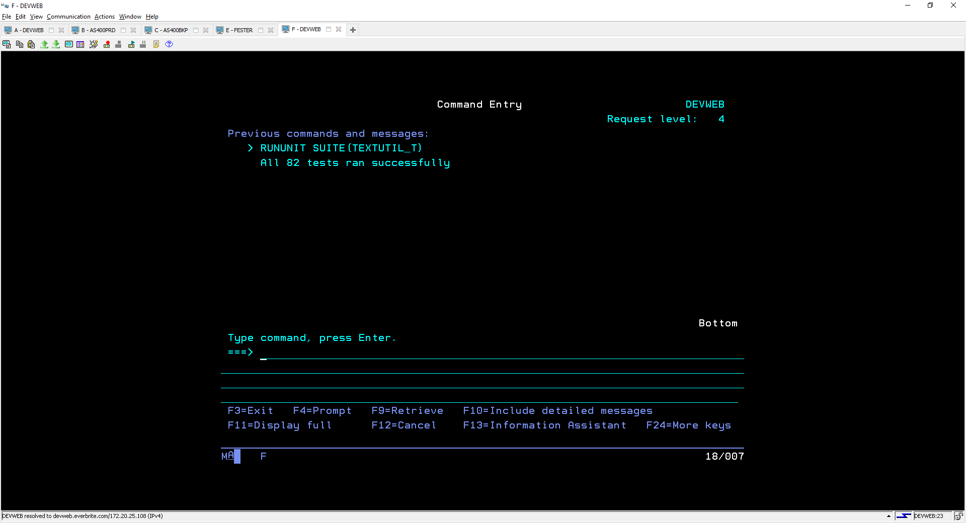
Run IBMiUnit Interactive

Slide 30
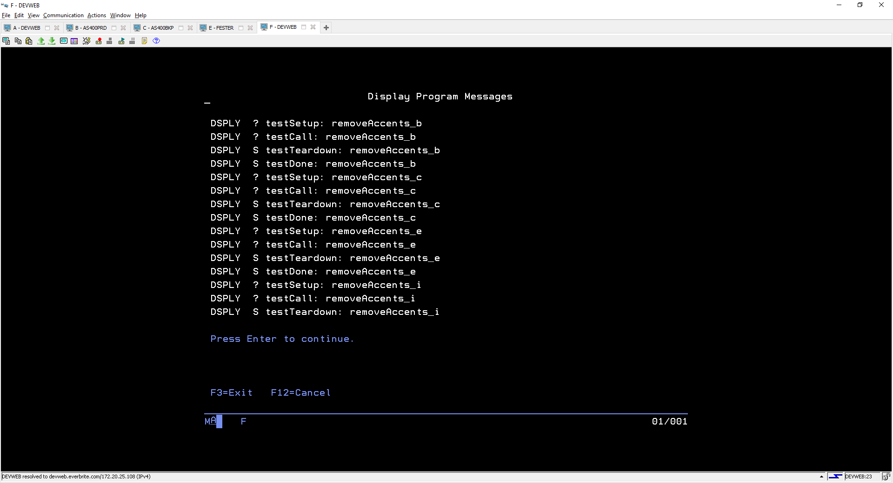
Run IBMiUnit Display

Slide 31
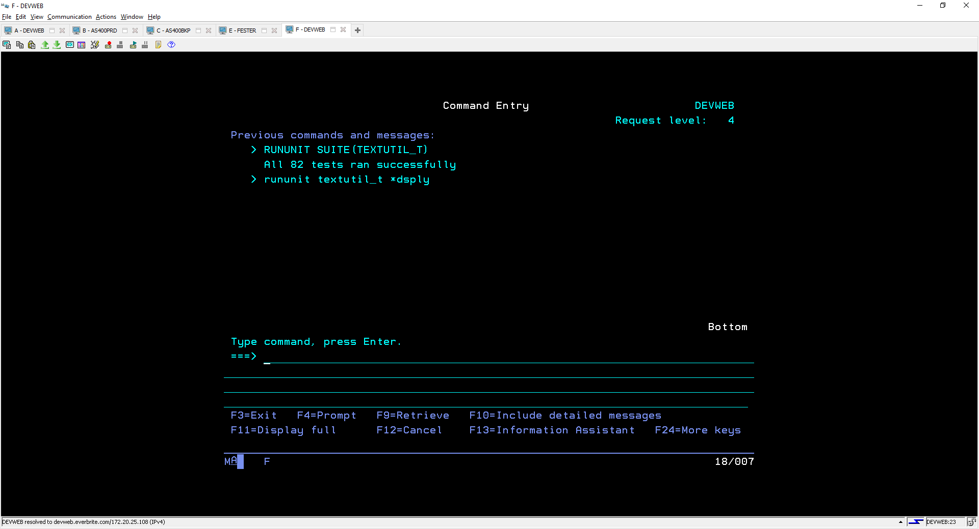
Display

Slide 32
Thank you!!
My contact Info
Marina Schwenk
marinaschwenk23@gmail.com
@marinaschwenk26 on twitter
Special Thanks:
Austin Narus, Network Security Administrator, Everbrite
Bryan Peterson, Application Developer, Everbrite
Steve Johnson-Evers, Lead Architect, Everbrite
Rochelle Petty, Application Support, Everbrite
Debbie Saugen, Owner, Debbie Saugen Consulting, LLC
Jeff (Red) Koon, RPG Developer

